Slide 1
OMEGA Module Weekly Meeting – Azure Cloud (PaaS/SaaS)
13-January-2026

Slide 2
Action Points Identified in Last Meeting
No. | Action Points | Raised Date | Status | Target Date | Remarks
1 | Modification of Pricing Model of VMs for Coforge Managed Application. | 16-06-2025 | On-Hold | TBC

Slide 3
Azure Platform Monitoring and Health Check
NAME | TYPE | RESOURCE GROUP | SUBSCRIPTION | Monitoring | Health Status
vm-ste-ap-dev-1 | Virtual machine | rg-safety-passport-dev-001 | indg-app-dev-001 | Solarwinds | Healthy
vm-ste-ap-prd-1 | Virtual machine | rg-safety-passport-prod-001 | indg-app-prod-001 | Solarwinds | Healthy
vm-ste-db-dev-1 | Virtual machine | rg-safety-passport-dev-001 | indg-app-dev-001 | Solarwinds | Healthy
vm-ste-db-prd-1 | Virtual machine | rg-safety-passport-prod-001 | indg-app-prod-001 | Solarwinds | Healthy
azapp-dev-transport-api | App Service | rg-transport_portal-dev | indg-app-dev-001 | Azure Monitors | Healthy
azapp-dev-transport-web | App Service | rg-transport_portal-dev | indg-app-dev-001 | Azure Monitors | Healthy
azapp-INSEE-Corporate-Websites | App Service | rg-insee-corporate-websites-dev-001 | indg-app-dev-001 | Azure Monitors | Healthy
azapp-INSEE-Corporate-Websites-prod | App Service | rg-insee-corporate-websites-prod-001 | indg-app-prod-001 | Azure Monitors | Healthy
azapp-redirect-conwood | App Service | rg-insee-corporate-websites-prod-001 | indg-app-prod-001 | Azure Monitors | Healthy
azapp-redirect-conwood-vn | App Service | rg-insee-corporate-websites-prod-001 | indg-app-prod-001 | Azure Monitors | Healthy
azapp-redirect-ecocycle-lk | App Service | rg-insee-corporate-websites-prod-001 | indg-app-prod-001 | Azure Monitors | Healthy
azapp-redirect-insee-vn | App Service | rg-insee-corporate-websites-prod-001 | indg-app-prod-001 | Azure Monitors | Healthy
azapp-redirect-inseeconcrete | App Service | rg-insee-corporate-websites-prod-001 | indg-app-prod-001 | Azure Monitors | Healthy
azapp-redirect-inseeecocycle | App Service | rg-insee-corporate-websites-prod-001 | indg-app-prod-001 | Azure Monitors | Healthy
azapp-redirect-siamcitycement | App Service | rg-insee-corporate-websites-prod-001 | indg-app-prod-001 | Azure Monitors | Healthy
azapp-redirect-siamcitycement-lk | App Service | rg-insee-corporate-websites-prod-001 | indg-app-prod-001 | Azure Monitors | Healthy
azapp-transport-api | App Service | rg-transport_portal-prod | indg-app-prod-001 | Azure Monitors | Healthy
azapp-transport-web | App Service | rg-transport_portal-prod | indg-app-prod-001 | Azure Monitors | Healthy
ISOSLAService-prod | App Service | rg-sccc-isosla-prod-001 | indg-app-prod-001 | Azure Monitors | Healthy
overviewcctv | App Service | rg-transport_portal-prod | indg-app-prod-001 | Azure Monitors | Healthy
SCCCAppService-prod | App Service | rg-sccc-automation-prod-001 | indg-app-prod-001 | Azure Monitors | Healthy
SCCCeDOSApp-prod | App Service | rg-sccc-automation-prod-001 | indg-app-prod-001 | Azure Monitors | Healthy
SCCCLogistic | App Service | rg-sccc-logistic-smartsilo-prod-001 | indg-app-prod-001 | Azure Monitors | Healthy
SCCCLogisticQAS | App Service | rg-sccc-logistic-smart-silo-dev-001 | indg-app-dev-001 | Azure Monitors | Healthy
SCCCLogisticWeb | App Service | rg-sccc-logistic-smartsilo-prod-001 | indg-app-prod-001 | Azure Monitors | Healthy
SCCCLogisticWebQAS | App Service | rg-sccc-logistic-smart-silo-dev-001 | indg-app-dev-001 | Azure Monitors | Healthy
Note:- This sheet contains Monitoring of all Critical Azure Application services Health Checks.

Slide 4
Azure Backup
Application Name | Backup Frequency | Resource Type | Resource Name | Backup Status | Remarks
Safety Passport | 24 hours | Virtual machine | vm-ste-ap-prd-1 | Successful
Safety Passport | 24 hours | Virtual machine | vm-ste-db-prd-1 | Successful
Safety Passport | 24 hours | SQL Database in Azure VM | vm-ste-db-prd-1\MSSQLSERVER | Successful
Transport Portal | 12 hours | SQL Database | indg-mdm-db | Successful
Transport Portal | 24 hours | SQL Database | dbserver-transport | Successful
Transport Portal | 24 hours | SQL Database | dbserver-transport-dev | Successful
Smart Silo | 12 hours | SQL Database | sqldb-testdev | Successful
Smart Silo | 24 hours | SQL Database | sqldb-gps_silo | Successful
Corporate Website | 24 hours | SQL Database | corperatewebsitedb-prod-001 | Successful
Corporate Website | 24 hours | SQL Database | corperatewebsitedb-qas | Successful
Note:- This sheet contains Monitoring of all Azure Backups managed by Coforge.

Slide 5
Azure Platform – Service Health
No. | Application Name | Service Health: Service issues, Planned maintenance, Health Advisories, Security advisories
1 | Smart Silo | No alert
2 | Transporter Portal | No alert
3 | Safety Passport | No alert
4 | Corporate Websites | No alert
5 | SharePoint Automation | No alert
6 | ISO SLA | No alert
7 | indg-platform-connectivity-prod-001 | No alert
8 | indg-infrastructure-archive-001 | No alert

Slide 6
Cost Utilization
S.No | Application Name | Monthly Budget | Month to Date | Reserved | Monthly Forecast | Forecast Vs Budget | Comments
1 | Smart Silo | $ 455.00 | $ 142.88 |  | $ 365.28 | 80.2%
2 | Transporter Portal | $ 345.00 | $ 124.02 |  | $ 317.07 | 91.9%
3 | Safety Passport | $ 1,380.00 | $ 473.52 | $ 204.00 | $ 1,414.6 | 102.5%
4 | Corporate Websites | $ 680.00 | $ 77.04 | $ 177.00 | $ 370.86 | 54.5%
5 | SharePoint Automation | $ 80.00 | $ 29.68 |  | $ 75.89 | 94.8%
6 | ISO SLA | $ 75.00 | $ 29.68 |  | $ 75.89 | 101.1%
7 | indg-platform-connectivity-prod-001 | $ 1,200.00 | $ 463.59 |  | $ 1,184.39 | 98.6%
8 | indg-infrastructure-archive-001 | $ 208.00 | $ 65.00 |  | $ 165.58 | 79.6%

Slide 7
Cost Analysis – Weekly Trends for Subscription
Subscription Name | 21-Dec to 27-Dec | 28-Dec to 03-Jan | 04-Jan to 10-Jan
indg-app-dev-001 | $139.89 | $139.85 | $140.03
indg-app-prod-001 | $366.33 | $363.64 | $366.56
indg-platform-connectivity-prod- 001 | $259.72 | $262.67 | $268.26
indg-infrastructure-archive-001 | $37.40 | $37.39 | $37.40

Slide 8
Cost Analysis – Weekly Trends for Applications
Application Name | 21-Dec to 27-Dec | 28-Dec to 03-Jan | 04-Jan to 10-Jan
Smart Silo | $82.49 | $82.49 | $82.49
Transporter Portal | $71.72 | $71.69 | $71.73
Safety Passport | $272.94 | $273.06 | $273.33
Corporate Websites | $45.69 | $43.21 | $45.86
SharePoint Automation | $17.14 | $17.14 | $17.14
ISO SLA | $17.14 | $17.14 | $17.14

Slide 9
Security
S. No. | Date of Occurance | Alert Name | Target Application | Email Confirmation | Status
No security alerts for this week.

Slide 10
Defender Recommendations
S.No | Severity | Vulnerabilities | Resource Type
1 | High | Azure SQL Database should have Azure Active Directory Only Authentication enabled | SQL DB
2 | High | SQL servers should have an Azure Active Directory administrator provisioned | SQL Servers
3 | High | Storage accounts should prevent shared key access | Storage Account
4 | Medium | Function App should only be accessible over HTTPS | App Service
5 | Medium | TLS should be updated to the latest version for web apps | App Service
6 | Medium | Web Application should only be accessible over HTTPS | App Service
7 | Low | Auditing on SQL server should be enabled | SQL Servers
8 | Low | EDR configuration issues should be resolved on virtual machines | Virtual Machine
9 | Low | Machines should be configured securely (powered by MDVM) | Virtual Machine
10 | Low | System updates should be installed on your machines (powered by Azure Update Manager) | Virtual Machine
11 | Low | VPN gateways should use only Azure Active Directory (Azure AD) authentication for point-to-site users | VPN Gateways

Slide 11
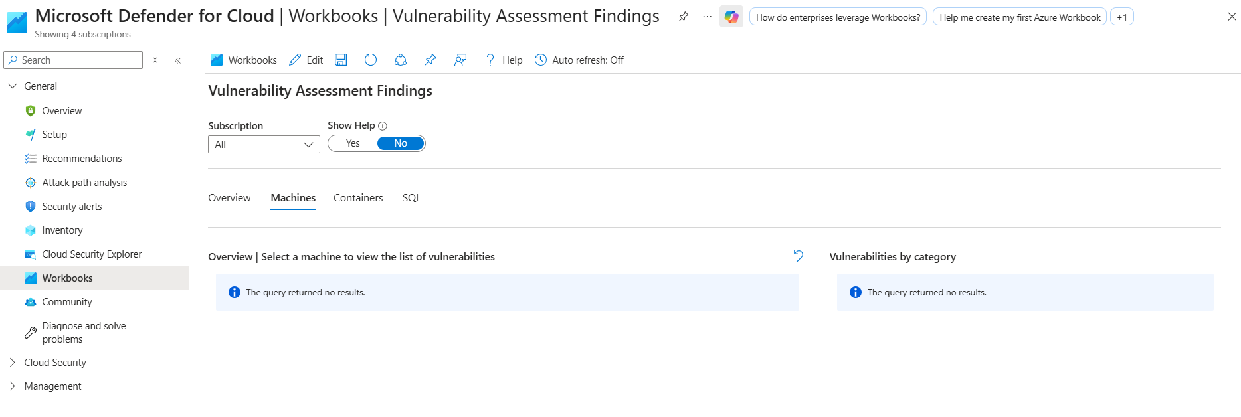
VA Status
No Vulnerabilities identified for any Coforge Managed Applications resources.

Slide 12
Ideas, Innovation and CSIPs
S.No | Category | Description | Priority | Status | Benefits | Proposed By | Owner | Start Month | Target End
1 | Idea | Tagging of all Azure Resources | High | Completed | Prevention from Scope Slippage. | Shubham Sharma | Kn. Piyadol | May'25 | June'25
2 | Idea | Creation of Single Architecture Diagram for all Coforge Managed Resources. | Medium | Open | Clearer understanding of Application and Network. | Shubham Sharma | Shubham Sharma | June'25 | Sept'25
3 | Idea | Requirement for Azure Firewall | Medium | Completed | Operational Benefit | Shubham Sharma | Shubham Sharma | June’25 | Aug'25
4 | CSIP | Migration of D series VM to E series | Medium | Open | Cost Optimization and future unplanned downtime prevention. | Shubham Sharma | Shubham Sharma | June’25 | July'25

Slide 13
Operational Summary and Points-to-be discussed
Architecture Diagram
  Shubham has completed the architecture diagram of Smart Silo Application along with its network connectivity.
  Shubham has completed the architecture diagram of Transporter Portal Application.
  Application Team will provide small KT session on Corporate Website Application to Azure Team as it is recently onboarded application.
Azure Recommendations
  The application team has raised a concern regarding the TLS upgrade. They have indicated that certain sensors currently in use only support older TLS 1.1, which may lead to compatibility issues after the upgrade.
  Application team has requested enabling TLS 1.1 for SCCCLogisticQAS app service.
  As requested by Application Team, Cloud-IMS team have enabled minimum TLS v1.1 for SCCCLogisticQAS app service.

Slide 14
Planned Downtime & Patching Activity
No. | Downtime Description | Location | System | Date | Duration (VN timezone) | Remarks
No planned Downtime for coming week.
Note: - Monthly Patching for Virtual Machines are planned on 1st Friday of every month.

Slide 15
Unplanned Downtime (past Week)
No. | Downtime Description | Location | System | Date | Duration (hrs.) | Remarks
No Unplanned Downtime for past week.

Slide 16
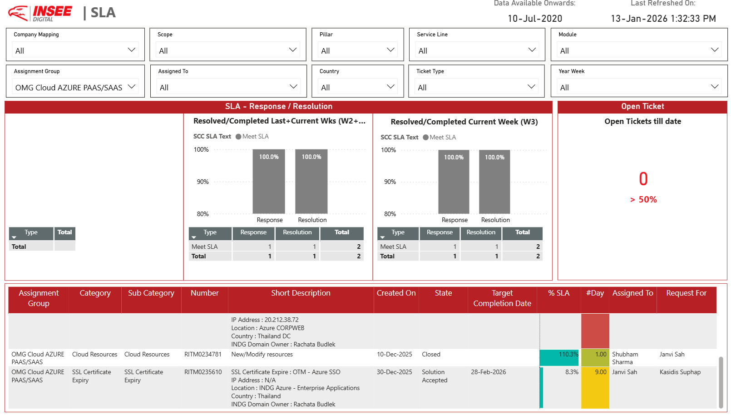
OMEGA SNOW Dashboard
Comments
We have one request, RITM0235610, for SSL renewal. The current certificate is set to expire on 28th Feb'26.

Slide 17
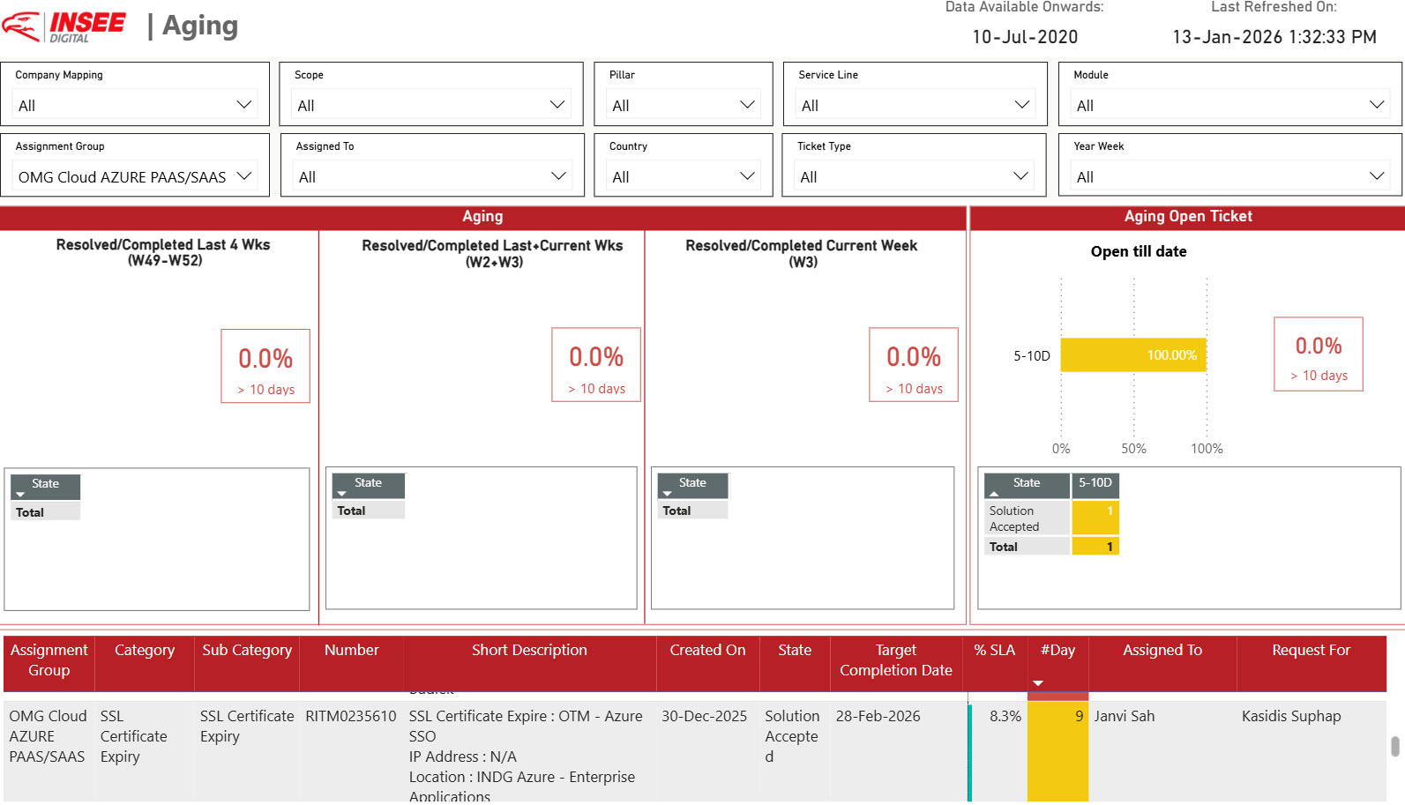
RITM Ageing
Comments

Slide 18
RITM Ageing >5 Days
RITM No. | Description | Created On | State | Target Completion Date | %SLA | #Day | Remark
RITM0235610 | SSL certificate renewal for*OTM-Azure SSO | 30-Dec-25 | Solution Accepted | 28-Feb-26 | 8.3 | 9 | A Service Catalog Task (SCTASK0153375) has been assigned to network team for generating the required SSL certificate. .

Slide 19
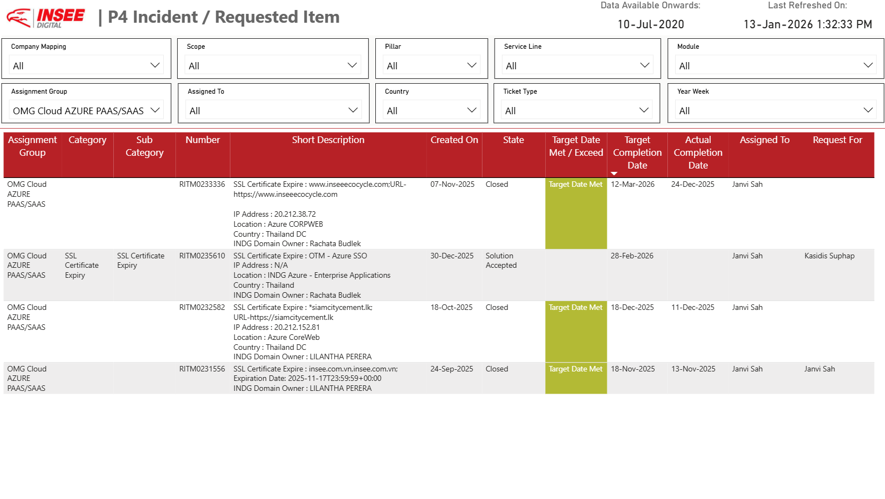
RITMs with Solution Accepted & Target Date
Comments

Slide 20
Major Planned Activities​
S.no | INC/RITM Number | CHG Number | Description | PIC | Planned Date | Planned Time | Remark
NA

Slide 21
Open Problem Ticket & Status
S.no | Problem Number | Description | Create Date | Target Date | State | Status | Remark
NA

Slide 22
Leave Plan for Next Week & Team Structure
 |  |  | Mon | Tue | Wed | Thu | Fri | Sat | Sun | Mon | Tue | Wed | Thu | Fri | Sat | Sun
 |  |  | 12-Jan | 13-Jan | 14-Jan | 15-Jan | 16-Jan | 17-Jan | 18-Jan | 19-Jan | 20-Jan | 21-Jan | 22-Jan | 23-Jan | 24-Jan | 25-Jan
Sn. | Name | Location
1 | Shubham Sharma (Domain Owner) | Off-shore
2 | Saroj Kumar Gupta | Off-shore
3 | Janvi Sah | Off-shore | L | L
4 | Ashutosh Padhi | Off-shore

Slide 23


